Slide 1

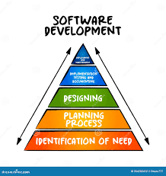
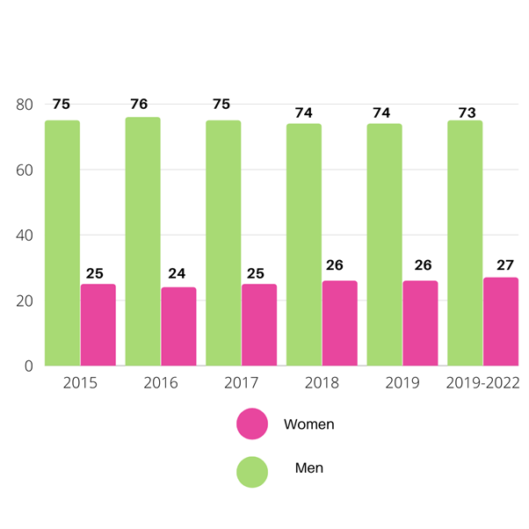

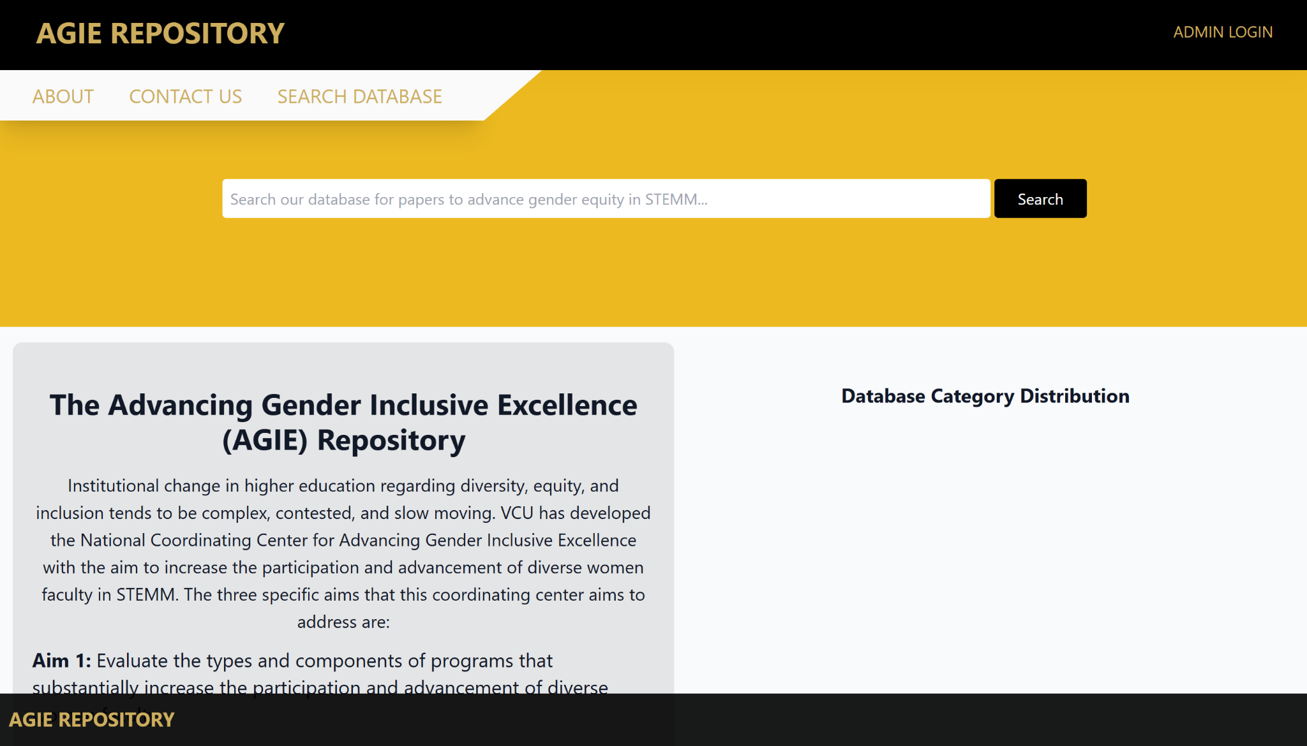

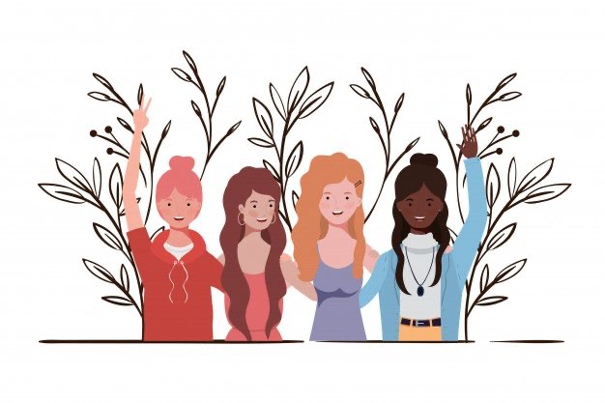
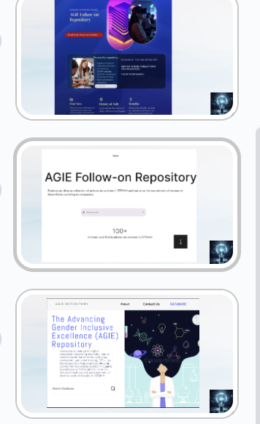





25-307
Developing a Central Repository for Gender Outcome Programs in STEMM: AGIE Follow-on
Team members: Stef Henry, Sofanyas Genene, Nahome Kifle, Alina Minor | Faculty adviser: Dr. John Leonard | Sponsor: VCU Health | Mentor: Susan Kornstein
Problem Statement
Current Application
Women are underrepresented in positions across STEMM fields.
This screenshot shows the application we inherited from last year's project, which had several unfinished pieces that needed further development. Our team is focused on refining these areas to enhance functionality and bring the application to completion.
Project Plan
Activities
Client Needs:
Centralized hub for researchers
User-friendly navigation for users
Refined and complete development
Website Goals:
Modular, flexible design
Dynamic interface with robust filtering features
Accessibility on all platforms
Technology Stack:
Docker & Docker Compose
MySQL database
React for front-end
Development Steps:
1.Requirements Gathering
2.Design and Prototyping
3.Back-End Development
4.Front-End Development
5.Testing and QA
6.Site Deployment
Our activities this semester included:
Team Contract:Established roles, responsibilities, and communicated guidelines
Project Proposal: Defined project scope, objectives, and deliverables
Database Prep:Gathered and curated articles for the repository
Landing Page Prototypes and Review:Designed and researched various prototypes and incorporated user feedback from our presentation to refine designs
Project Overview
Our project enhances a centralized repository to promote gender diversity in STEMM, connecting resources to empower women and highlight the challenges faced by underrepresented genders.
Future Directions
Our future application will feature:
A sleek, modern design inspired by our top landing pages
Focus on clean layout and intuitive navigation
Database search functionality for easy information filtering
Streamlined, visually engaging interface
Refined, polished experience to attract users from the first interaction
Notes:
Problem Statement, Project Overview, and layout/design:(Alina)
Project Plan: (Insert name)
Activities for this Semester:(Insert name)
Current Application screenshot/Future Directions:(Stef)

